Slide 1


Conor Shanahan
12 NOV 2024

Slide 2

Outline
Executive Summary
Introduction
Methodology
Results
Conclusion
Appendix

Slide 3
Executive Summary
Methods
Data was collected using the SpaceX Web API and by scraping the SpaceX Wikipedia page containing Falcon 9 Launches. Data wrangling was performed primarily to encode the target variable specifically whether the booster landed successfully for different launches.
SQL queries and data visualization were used to explore the data, allowing for the generation of insights.
Lastly, predictive analysis was completed using four different modeling methods: Logistic Regression, Support Vector Machine (SVM), K-Nearest Neighbors (KNN), and Decision Tree.
Summary of all results
Maybe add something
Each of the predictive models was found to perform equally well on the validation data with each model receiving an accuracy score of 83.33%

Slide 4
Introduction
In recent years there has been a growing number of companies in the private sector which have shown the ability to make space exploration possible. SpaceX is a company headed by Elon Musk that has been arguably most successful in this area. This can be attributed to SpaceX’s ability to reuse the first stage of their rockets, specifically the Falcon 9 rocket. As someone working for a rival space exploration company, we are interest in determining if the first stage of a rocket will land, generating insight into the cost of the launches.
Key Questions:
What data is available on Falcon 9 launches that can be used for such modeling?
What insights can be generated from EDA and data visualization?
Does the data need to be transformed and/or engineered for modeling?
Can a model predict whether the first stage of a Falcon 9 rocket will successfully land and if so, which model performs the best?

Slide 5

Section 1

Slide 6
Methodology
Executive Summary
Data collection methodology:
Data was collected from the SpaceX API and the Falcon 9 Wikipedia Launch Table.
Perform data wrangling
Data was cleaned and target variable was encoded in preparation for modeling
Perform exploratory data analysis (EDA) using visualization and SQL
Perform interactive visual analytics using Folium and Plotly Dash
Perform predictive analysis using classification models
Models were tuned using GridSearchCV with 10 validation folds and a parameter dictionary.
Models were then scored on the validation data to assess performance.

Slide 7
Data Collection
Describe how data sets were collected.
You need to present your data collection process use key phrases and flowcharts

Slide 8
Data Collection – SpaceX API
SpaceX has a publicly available API which can be used to retrieve information about their launches.
Extract data from API response and convert date format
Generate columns of interest and populate columns with data from API response
Combine data into data frame
Filter only Falcon 9 launches and replace missing column values with mean
https://github.com/CWS01/Predicting-Successful-Stage-1-Return/blob/262cbafb1cb23771eb0b8ca75f089a7edde1581f/Data_Collection_Using_SpaceX_API.ipynb
Place Call to API
Extract nested data and convert date format
Use defined functions to generate columns of interest.
Combine columns into Data Frame
Apply filter so only Falcon 9 Launches are being observed
Replace missing values with mean value.

Slide 9
Data Collection - Scraping
Import Beautiful Soup and Requests
Get HTML using Requests
Create Beautiful Soup object from the text of the response of request
Find all tables on the page
Extract column names from first launch table
Parse tables to get relevant information and store in dictionary
Convert dictionary to a Data Frame
Tables with launch data for various SpaceX launches are available on Wikipedia.
These tables can be scraped using Beautiful Soup to extract relevant information that can then be stored in a pandas data frame for further analysis.
Link: https://github.com/CWS01/Predicting-Successful-Stage-1-Return/blob/019f042b317eb4d90b81f7f11de9cedf946fe68c/Data_Collection_Web_Scraping.ipynb

Slide 10
Data Wrangling
The CSV file generated in the previous section was first loaded as a data frame.
The number of launches from the different launch sites was then observed. Followed by the number of rockets launched into the different orbits.
The different types of landings were looked at the count of each was assigned to a variable. This variable was then used to create a new column titled “Outcome” in the data frame.
Unsuccessful landings were encoded as a 0 and successful landings were encoded as a 1.
Link:
Load CSV
Observe number of launches from different launch sites
Observe number of launches to different orbits
Observe different outcomes of launches and store in variable
Encode new column "Outcome" with successful (1) and unsuccessful (0)
Save to CSV

Slide 11
EDA with Data Visualization
Launch Site Trends
Landing outcome was observed as a function of flight number and launch site using a scatter plot
Landing outcome was observed as a function of payload mass and launch site using a scatter plot
Orbit Type Trends
Landing success rate by orbit type was visualized using a bar chart
Landing outcome was observed as a function of flight number and orbit type using a scatter plot
Landing outcome was observed as a function of payload mass and orbit type using a scatter plot
Yearly Trends
Average landing outcome each year since 2010 was plotted as line chart
Link: https://github.com/CWS01/Predicting-Successful-Stage-1-Return/blob/226fb7831caa047d0fe1278f2b681b410303e6b4/EDA_Data_Visualization.ipynb

Slide 12
EDA with SQL
The following SQL queries were performed:
Unique launch sites
5 launch records from a site beginning with “CCA”
Total payload mass carried by boosters launched by NASA
Average payload mass carried by booster version “F9 v1.1”
Date of first successful ground pad landing
Successful drone ship landings with payloads between 4000 and 6000 kg
Total number of successful vs unsuccessful landings
Boosters which have carried the maximum payload mass
Drone ship landing failures in 2015
Count of different landing outcomes between the date 06/04/2010 and 03/20/2017
Link: https://github.com/CWS01/Predicting-Successful-Stage-1-Return/blob/66d457c1a92c7459c77afc82b6afa2f07df759e9/EDA_SQL.ipynb

Slide 13
Build an Interactive Map with Folium
Folium Map Objects
Circles were added to mark the different launch sites for the rockets
Markers were added to label each of the launch sites with their respective names
Landing outcomes were encoded with either “red” or “green” to mark successful vs. unsuccessful launches
Marker clusters were used to show the different landing outcomes on the map
Lines were added to the map to show the distance from a specific launch site to different landmarks. The landmarks of interest were:
Coastline
Highway
Railroad
City
Link: https://github.com/CWS01/Predicting-Successful-Stage-1-Return/blob/baafb8b46f60d53deabb0fb68a3fb93f04943376/Data_Visualization_Folium_Map.ipynb

Slide 14
Build a Dashboard with Plotly Dash
A dashboard was created for interactive visualization of some rocket launch information.
A dropdown menu was added to select a single launch site or all launch sites
The first graph is a pie chart
When all sites are selected, the pie chart shows the percentage of successful landings that can be attributed to individual sites.
When one site is selected the pie chart shows the ratio of successful vs. unsuccessful landings at that specific site.
A slider was added to filter on different ranges of payload mass carried by a mission
The second graph is a scatter plot
The scatter plot shows the landing outcome as a function of payload mass and booster version. Note: the payload mass can be adjusted using the slider.
Link:

Slide 15
Predictive Analysis (Classification)
Load preprocessed data frame
Create target variable and features variable. Transform if necessary.
Split data into training and testing sets
Create four different models and tune hyperparameters using cross-validation
Assess accuracy of model on test data
Data was loaded, split into target and feature arrays, and transformed if necessary.
Data was split into training and testing sets
Four models were created and trained on training data:
Logistic Regression
Support Vector Machine (SVM)
Decision Tree
K-Nearest Neighbors (KNN)
Hyperparamters to test were defined and cross validation using GridSearchCV was completed.
Accuracy was then assessed on test data using the hyperparameters selected during cross-validation
Link:

Slide 16

Section 2

Slide 17
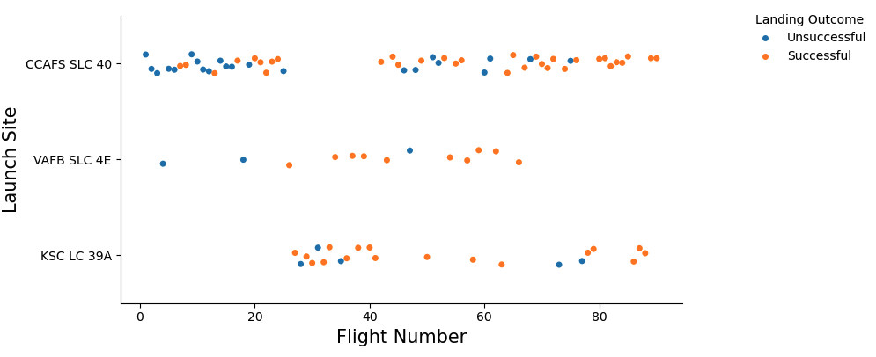
Flight Number vs. Launch Site
The above scatter plot shows the landing outcomes based on flight number and launch site.
Successful launches appear to increase with increasing flight number.

Slide 18
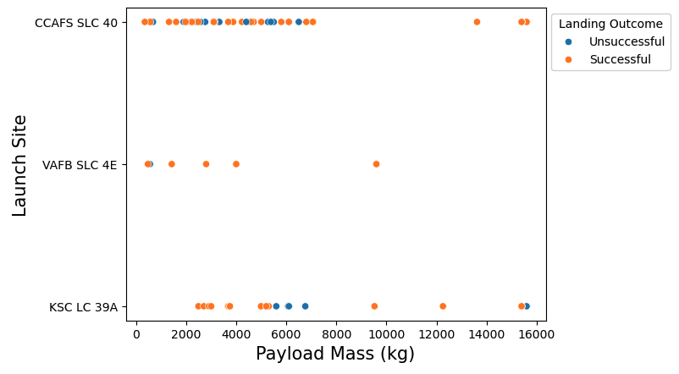
Payload vs. Launch Site
The scatter plot to the right shows landing outcome as a function of launch site and payload mass.
There does not appear to be any specific trends. However, there does appear to be more failures around a 6000kg payload mass when launching from KSC LC 39A

Slide 19
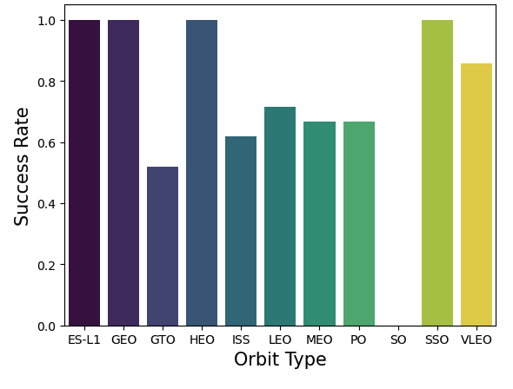
Success Rate vs. Orbit Type
The bar chart to the right shows the success rate of landings based on the destination orbit.
ES-L1, GEO, HEO, and SSO target orbits have resulted in 100% successful landings.
SO target orbit has resulted in 0% successful landings.

Slide 20
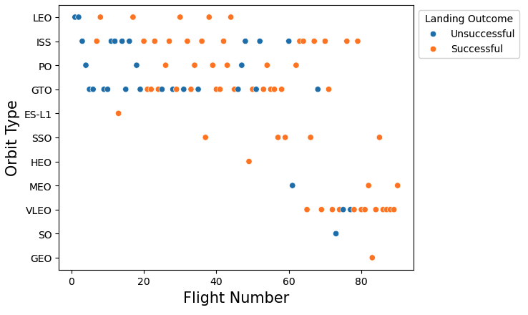
Flight Number vs. Orbit Type
The scatter plot to the right shows the effects of flight number and orbit type on landing outcome.
This plot again reiterates the fact that as flight number increases there appears to be more successful landings.

Slide 21
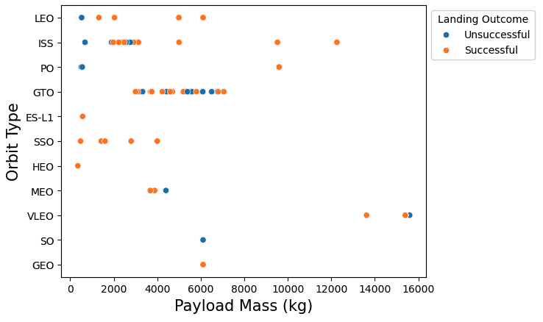
Payload vs. Orbit Type
The effects of orbit type and payload mass on landing outcome are shown to the right.
Most failures in the graph appear to be associated with smaller payloads and the GTO orbit, but no clear correlation is observed.

Slide 22
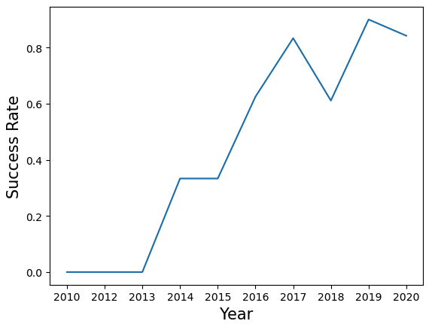
Launch Success Yearly Trend
The landing success rate as a function of year is shown to the right.
The success rate has grown significantly since 2010, reaching a high of ~85% in 2019.

Slide 23
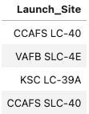
All Launch Site Names
Query: SELECT DISTINCT(Launch_Site) FROM SPACEXTABLE;
Result:
Explanation: The query selects all the distinct launch sites in the data frame, of which there are four.

Slide 24
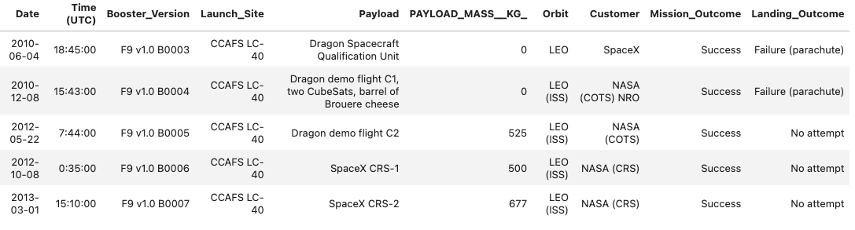
Launch Site Names Begin with 'CCA'
Query: SELECT * FROM SPACEXTABLE WHERE Launch_Site LIKE 'CCA%' LIMIT 5
Result:
Explanation: Used to further explore the data.

Slide 25
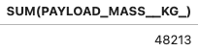
Total Payload Mass
Query: SELECT SUM(PAYLOAD_MASS__KG_) FROM SPACEXTABLE WHERE Customer LIKE 'NASA (CRS)%’
Result:
Explanation: The sum of payload mass carried by boosters from “NASA (CRS)” is 48,213kg.

Slide 26
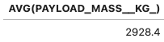
Average Payload Mass by F9 v1.1
Query: SELECT AVG(PAYLOAD_MASS__KG_) FROM SPACEXTABLE WHERE Booster_Version = 'F9 v1.1’
Result:
Explanation: The average payload mass carried by booster version “F9 v1.1” is 2928.4kg.

Slide 27
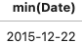
First Successful Ground Landing Date
Query: SELECT min(Date) FROM SPACEXTABLE WHERE Landing_Outcome = 'Success (ground pad)’
Result:
Explanation: The first successful landing outcome on ground pad was found to be on December 22, 2015.

Slide 28
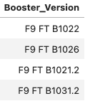
Successful Drone Ship Landing with Payload between 4000 and 6000
Query:
SELECT Booster_Version FROM SPACEXTABLE
WHERE (Landing_Outcome = 'Success (drone ship)') AND (PAYLOAD_MASS__KG_ BETWEEN 4000 AND 6000)
Result:
Explanation: There were four booster versions carrying a payload between 4000 and 6000kg which had a successful landing outcome on a drone ship.

Slide 29
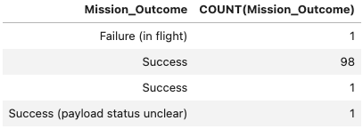
Total Number of Successful and Failure Mission Outcomes
Query:
SELECT Mission_Outcome, COUNT(Mission_Outcome) FROM SPACEXTABLE
GROUP BY Mission_Outcome
Result:
Explanation: There were 100 successful missions and only one mission failure.

Slide 30
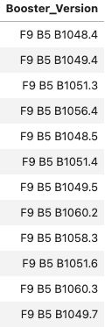
Boosters Carried Maximum Payload
Query:
SELECT Booster_Version FROM SPACEXTABLE
WHERE PAYLOAD_MASS__KG_ = (SELECT max(PAYLOAD_MASS__KG_) FROM SPACEXTABLE)
Results:
Explanation: There were 12 booster versions that have carried the maximum payload

Slide 31
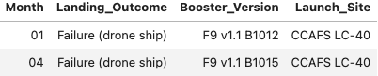
2015 Launch Records
Query:
SELECT substr(DATE, 6, 2) AS Month, Landing_Outcome, Booster_Version, Launch_Site FROM SPACEXTABLE WHERE Landing_Outcome = 'Failure (drone ship)' AND substr(Date, 0, 5) ='2015’
Results:
Explanation: There were two failed drone ship landings in the year 2015. The first occurred in January and the second occurred in April

Slide 32
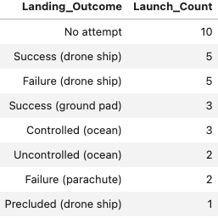
Rank Landing Outcomes Between 2010-06-04 and 2017-03-20
Query:
SELECT Landing_Outcome, COUNT(Landing_Outcome) AS Launch_Count FROM SPACEXTABLE
WHERE Date BETWEEN '2010-06-04' AND '2017-03-20'
GROUP BY Landing_Outcome
ORDER BY Launch_Count DESC
Result:
Explanation: There were 31 total landing attempts between June 6, 2010 and March 20, 2017. The most common was “No attempt.”

Slide 33

Section 3

Slide 34
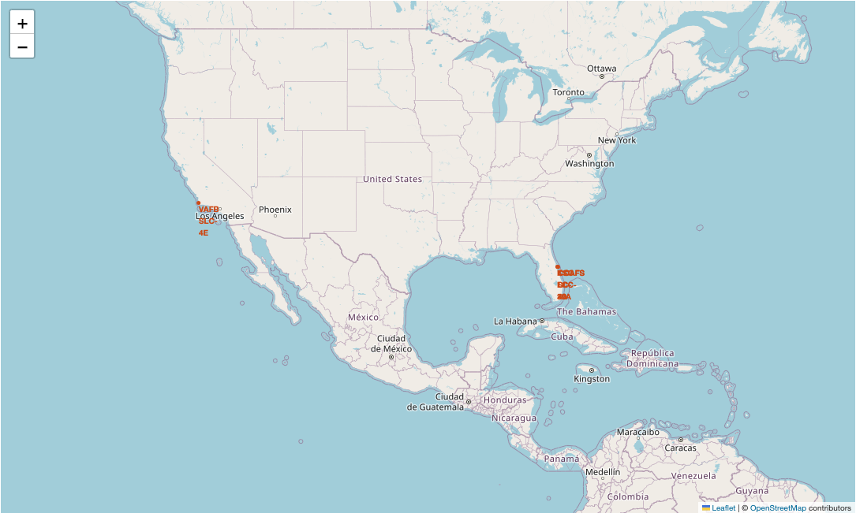
Launch Site Locations
VAFB SLC-4E (California, USA)
KSC LC-39A (Florida, USA)
CCAFS LC-40 (Florida, USA)
CCAFS SLC-40 (Florida, USA)

Slide 35
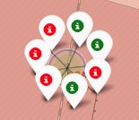
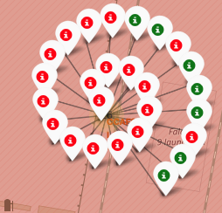
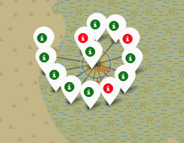
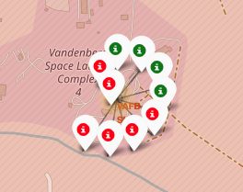
Successful/Unsuccessful Landings per Launch Site
CCAFS SLC-40
CCAFS LC-40
KSC LC-39A
VAFB SLC-4E
The above screen shots show the different landing outcomes, successful (green) and unsuccessful (red), for the different launch sites.
The relative landing outcome success rate per launch site can be inferred from this information.

Slide 36
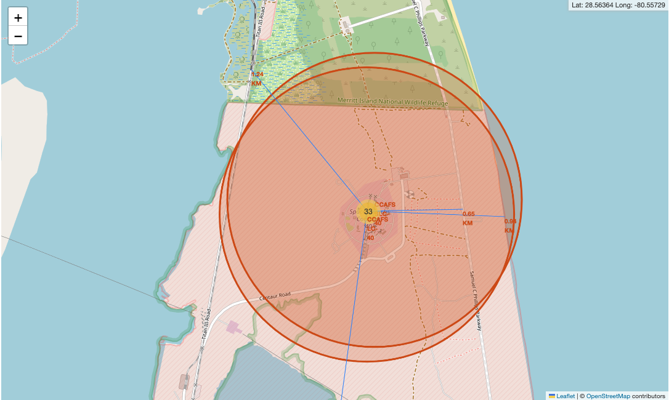
Distance from Launch Site to Different Landmarks
The CCAFS LC-40 launch site is ~0.94 km away from the nearest coastline.
The launch site is ~0.65km away from the nearest highway.
The launch site is ~1.24km away from the nearest railroad.
The launch site is ~19.82km away from the nearest city.

Slide 37

Section 4

Slide 38
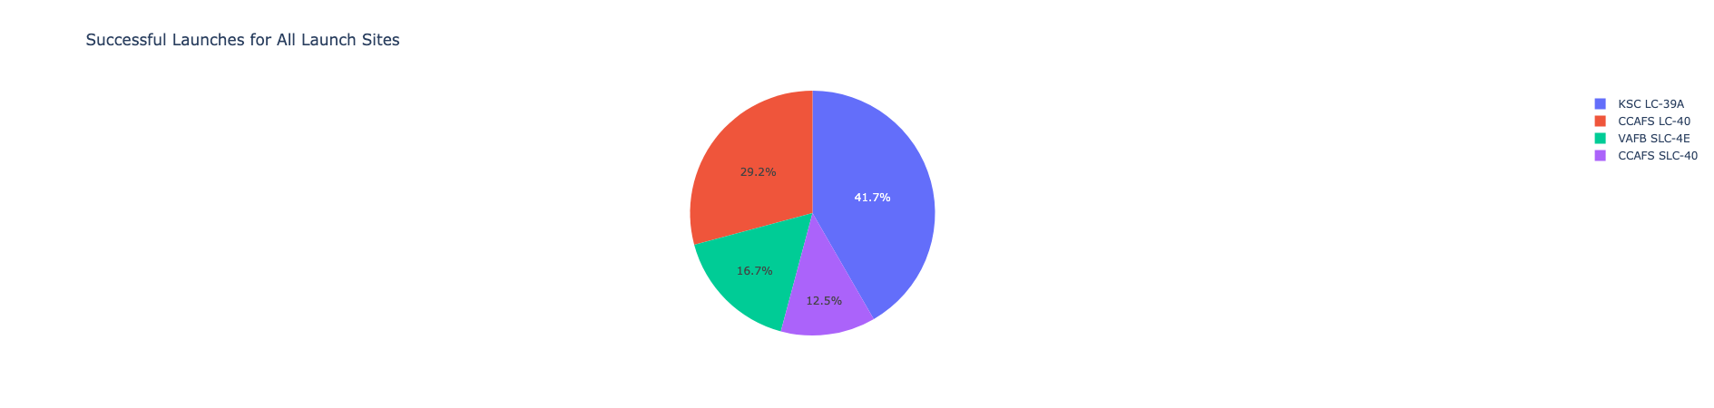
Landing Outcome Success Distribution by Launch Site
The above pie chart shows the distribution of successful landings according to launch site.
The launch site with the most successful landings is KSC LC-39A with 41.7% of the total successful landings.

Slide 39
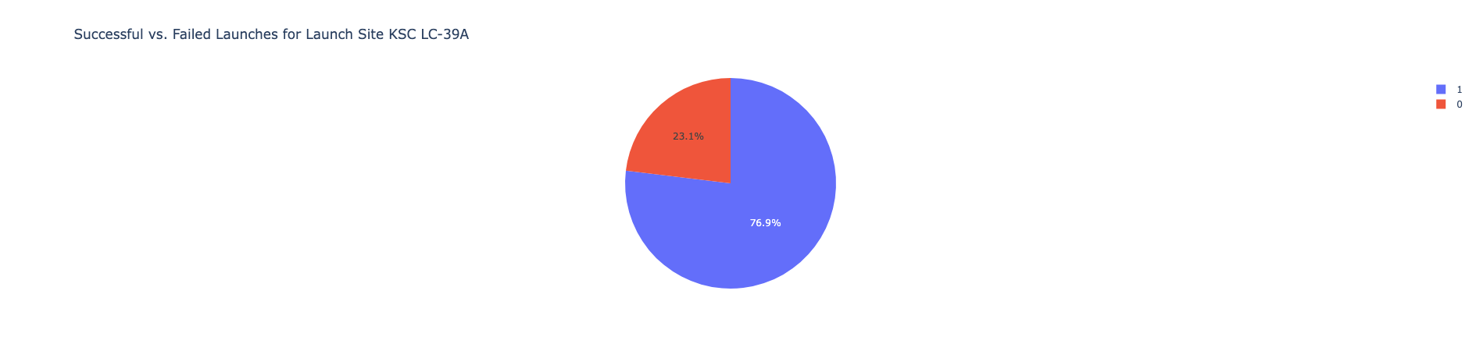
Landing Outcome Distribution for Launch Site KSC LC-39A
The above plot shows the distribution of unsuccessful and successful launches at the launch site: KSC LC-39A.
Out of all attempted landings, 76.9% were successful and 23.1% were unsuccessful.

Slide 40
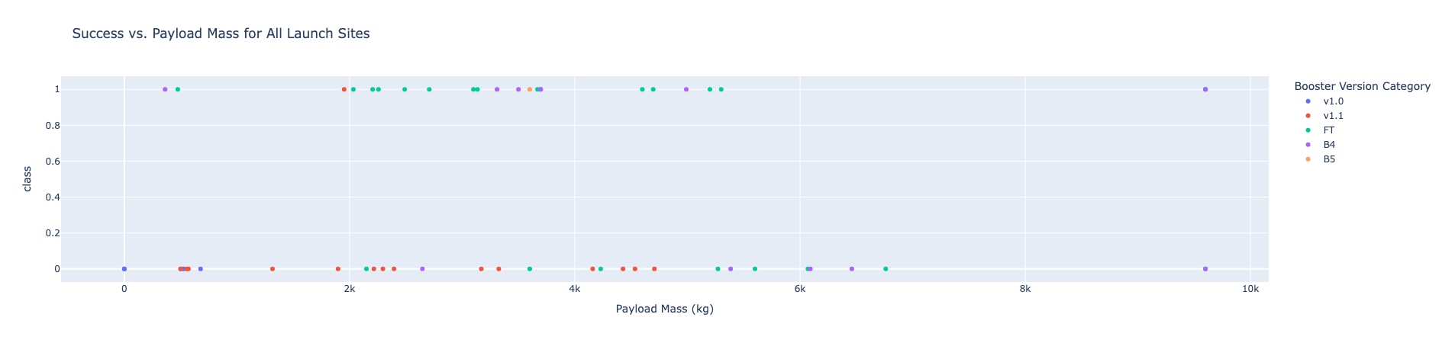
Landing Outcome vs. Payload Mass
The above plot shows the landing success as function of payload mass and booster version.
This plot can be filtered based on payload mass and launch site (not shown but functionality is present in dashboard)
Most successful launches occurred with a payload mass between 2000 and 6000kg and booster version FT

Slide 41

Section 5

Slide 42
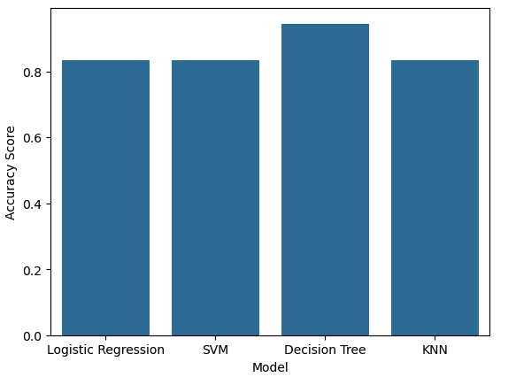
Classification Accuracy
The accuracy of each model on the test data is shown in the bar graph on the right.
The logistic regression, SVM, and KNN models each had an accuracy score of 83.33%.
The Decision Tree model had an accuracy score of 94.44%, the highest of any of the models.

Slide 43
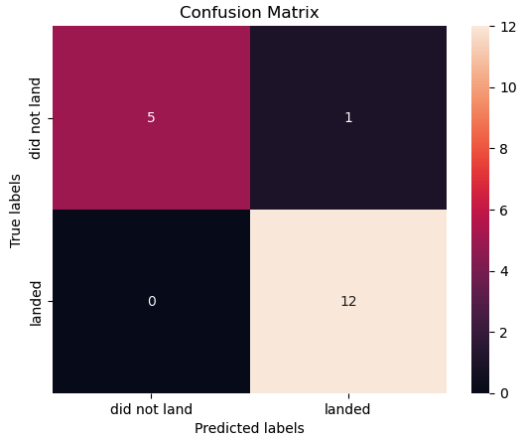
Confusion Matrix
The confusion matrix for the decision tree model is shown on the right.
The model had 17/18 outcomes correctly predicted.
The one incorrect classification was a false positive where the model predicted a successful landing but in truth the landing was unsuccessful.

Slide 44
Conclusions
Sufficient data can be extracted from the SpaceX API and publicly available data such as launch tables on Wikipedia.
As both more launches are made (and time goes on) SpaceX has shown that successful Falcon 9 landings are increasing.
Payload doesn’t seem to have a high correlation with landing outcome, but many successful landings were achieved with payload between 2000 and 6000kg.
Launch sites are in close proximity to coastlines, highways, and railroads, but are not in close proximity with cities.
The decision tree machine learning model can be used to predict successful landing with 94.4% accuracy. The other models can predict successful landing with 83.33% accuracy.

Slide 45


